Slide 1

Intro to the CSBC/PS-ON Summer Undergraduate Research Program & miniDREAM ‘Challenge’
Shannon Hughes, Ph.D.
Division of Cancer Biology
240-276-6224
shannon.hughes@nih.gov
James Eddy, Ph.D.
Sage Bionetworks
james.eddy@sagebionetworks.org

Slide 2
Agenda
Introductions
Overview of CSBC and PS-ON
Goals for the Summer
Expectations for the Summer
Team Activities
Mini-DREAM (James Eddy)

Slide 3

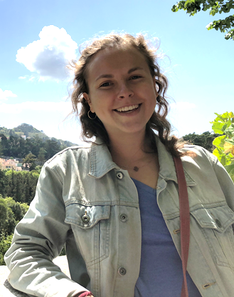
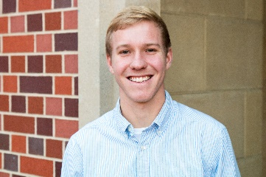
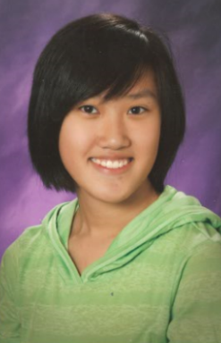
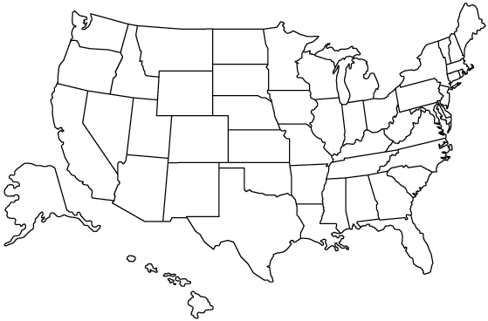
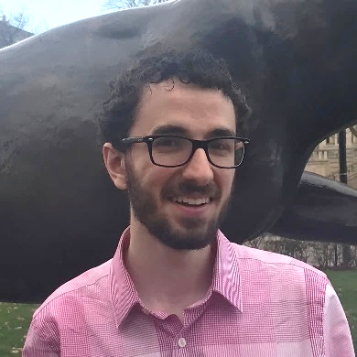

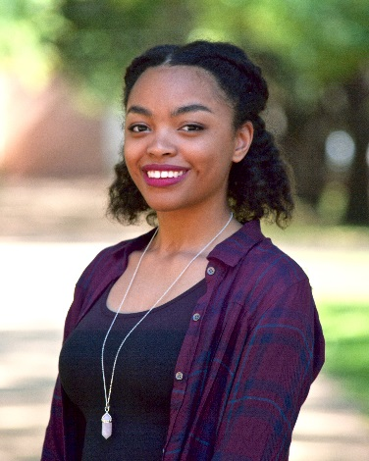
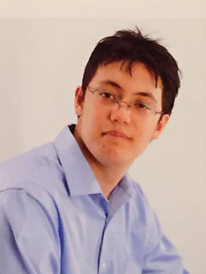
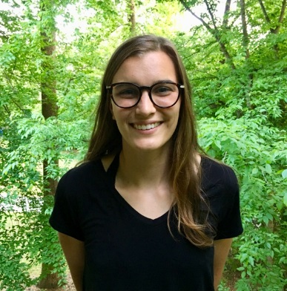
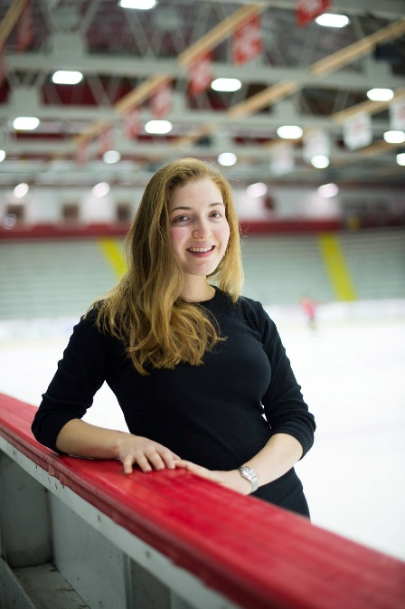
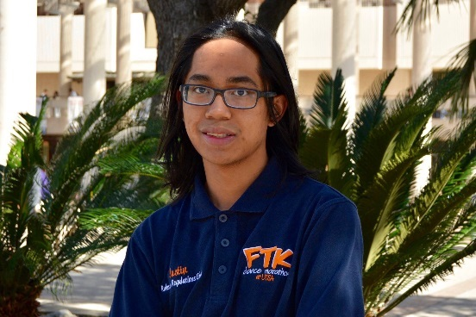
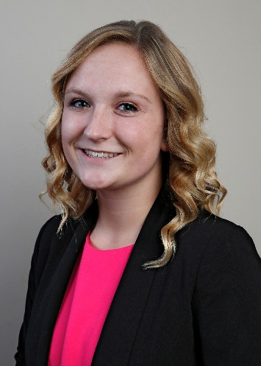
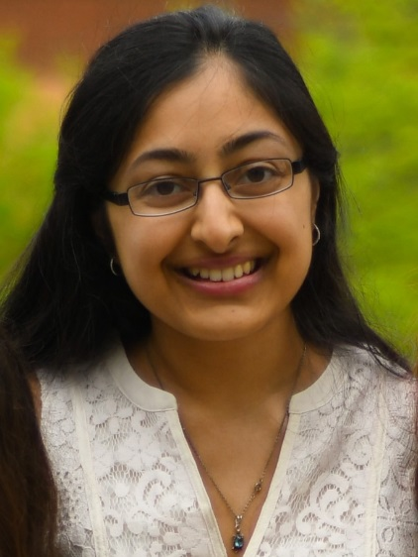
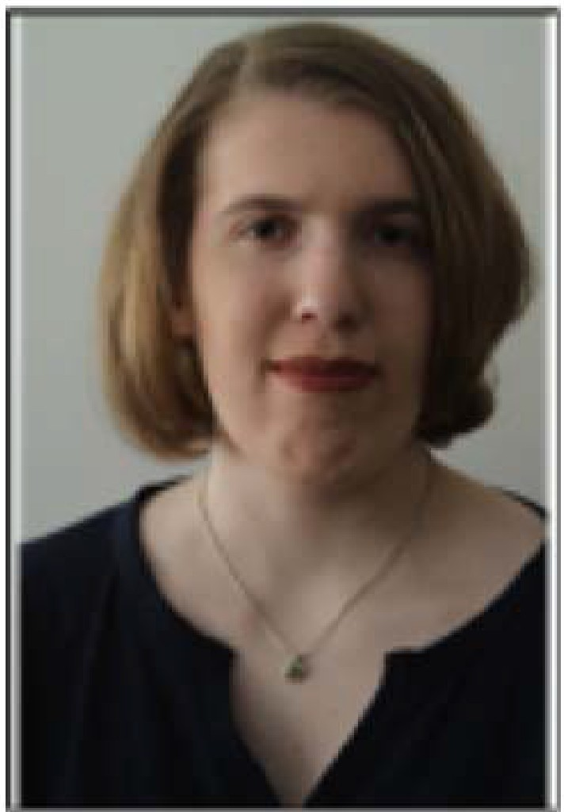
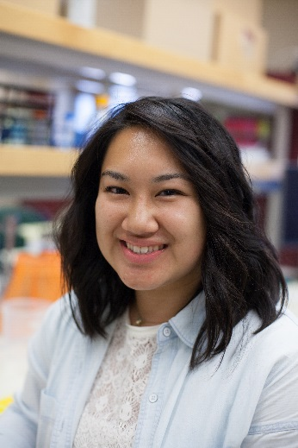
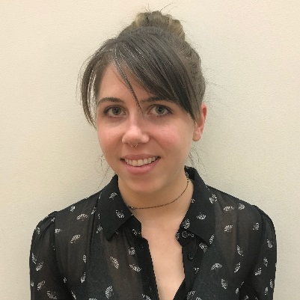
CSBC
Nathan R.
PS-ON
Maggie B.
Tiffany C.
Ryland M.
James H.
Edwin N.
Kalia P.
Alex W.
Morgan G.
Ruth K.
Sydney C.
Justin G.
Manisha K.
Mina D.
Morgan T.
Breelyn K.

Slide 4
Meredith L.
Gabrielle R.
Paula F.
Sami S.
Rupal K.
Yunxin O.
CSBC
Maggie B.
Marcus K.
Katelyn S.
Nathan R.
PS-ON
Tiffany C.
Ryland M.
Beril T.
James H.
Edwin N.
Aliasger E.
Lauren P.
Christie K.
Viswajit K.
Cameron H.
Kalia P.
Pu Z.
Zipeng W.
Alex W.
Morgan G.
Ruth K.
Sydney C.
Vincent H.
Justin G.
Manisha K.
Mina D.
Morgan T.
Breelyn K.

Slide 5
NCI Program Staff:
Shannon Hughes, Nas Zahir, and Elyse Gillen
Leidos Biomedical Research Staff:
Alison Scott & Corinne Zeitler
Sage Bionetworks Team:
James Eddy & Julie Bletz

Slide 6
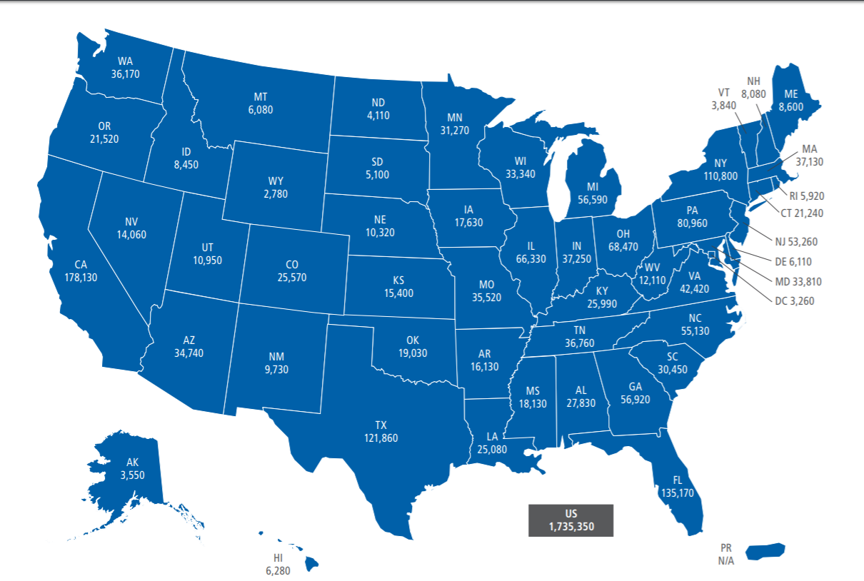
>1.7M Americans will be diagnosed with cancer in 2018
*These numbers exclude skin cancers and in situ carcinomas
ACS 2018 Cancer Statistics: http://bit.ly/Cancer_stats
Notes:
Cancer is a debilitating disease that continues to be a leading cause of death. Cancer is the 2nd leading cause of death in the US and projected to kill nearly 600,000 Americans in 2016. The number of newly diagnosed Americans in 2016 is estimated to be more than 1.6 million, which is roughly 4600 new diagnoses each day.

Slide 7
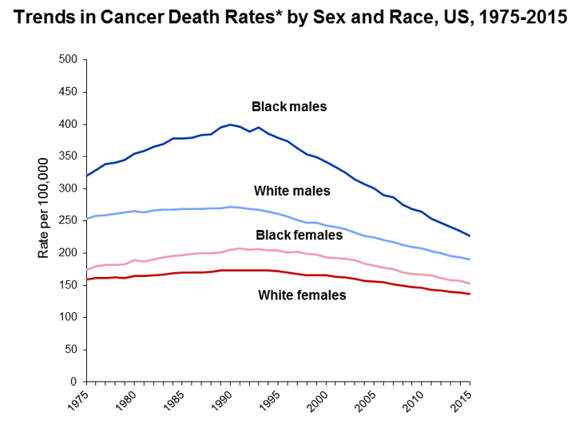
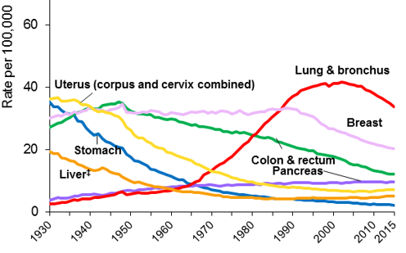
But…Progress is Hopeful and More Work Needs to be Done
The incidence of cancer is decreasing for the most common types – but there are exceptions
Female Cancer Death Rates (to 2015)
Modified from ACS 2018 Cancer Statistics: http://bit.ly/Cancer_stats
Notes:
Cancer is a debilitating disease that continues to be a leading cause of death. Cancer is the 2nd leading cause of death in the US and projected to kill nearly 600,000 Americans in 2016. The number of newly diagnosed Americans in 2016 is estimated to be more than 1.6 million, which is roughly 4600 new diagnoses each day.

Slide 8

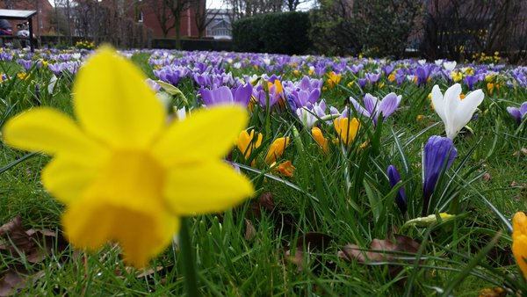

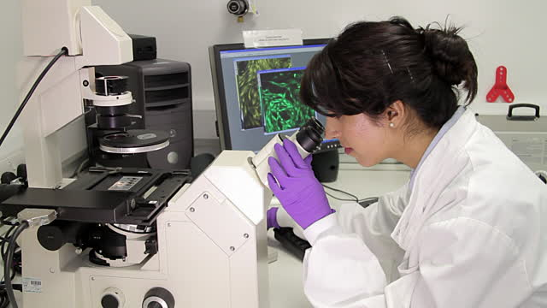
Can we bring new approaches to cancer research? How Things Appear is Always a Matter of Perspective . . .
Notes:
So new approaches and perspectives are needed to understand the complexity, of cancer and that has been the premise of bridging physical sciences with oncology at the NCI since 2009. Physical sciences perspectives & approaches provide complementary, new insights to understanding and treating cancer. Mathematicians, physicisits, engineeris,chemists and other physical scientists bring a complementary viewpoint from clinicians and biologists and that is why you are working together.

Slide 9
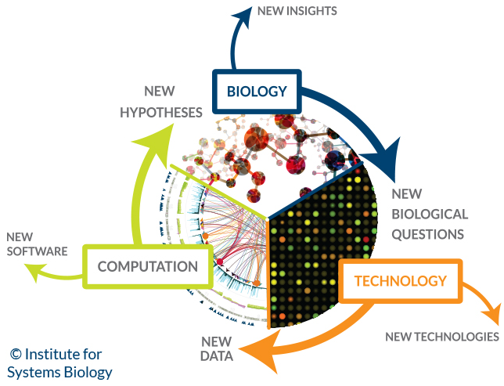
The PS-ON and CSBC investigators bring new approaches to cancer research
Multiple Viewpoints = Enhanced Insight & Efficient Problem Solving
Complex Cancer Questions
New theory
Mathematical modeling
Big data analysis
Physical science-based measurements
High-throughput measurements
Modified figure from systemsbiology.org

Slide 10
Program Overview:
This summer we aim:
To provide a new experience to push you past your “comfort zone”
To facilitate an understanding and appreciation of major questions currently under investigation within the CSBC and PS-ON through mentored research projects and/or laboratory work, faculty lectures, seminars, discussions and other activities.
To help you achieve a better idea of what you do (and don’t!) like in the research field
Logistics:
10-week program: early June – early August 2017
Stipend, housing, and travel at no cost to you
Mid-summer retreat at NIH Bethesda (June 25-26, 2018)
Logistics contacts: Alison & Corinne

Slide 11
Program Expectations:
You have some expectations of us:
That we have designed a summer experience that will be challenging, novel, and (most of all) fun.
That your workload is reasonable and expectations are clear
That we will treat you with respect
That we will give everyone an equal chance at success
We have some expectations of you:
That you will come to lab prepared to learn and excited for the challenge
That you will ask if expectations are not clear
That you will treat everyone with respect
That you will offer honest and frequent feedback

Slide 12
2018 Summer Team Activities:
Mini-DREAM Challenge
Kick-off TODAY!
Goal: Introduction to big-data analysis and modeling in breast cancer
What you’ll learn:
Biology of breast cancer metastasis
Statistical analysis in R and mechanistic modeling in matlab
How to use the Synapse virtual collaboration space
June Summer Research Conference
June 25-26, 2018 @ NIH Bethesda
Goal: Network with CSBC & PS-ON scientists and present your project
What you’ll need:
A ferocious curiosity and a laptop
A poster with your project background, motivating question and hypothesis

Slide 13
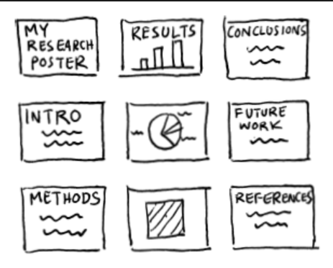
WHAT??? A poster??? I just started…
Instead of your results, use data from a background paper
Don’t panic.
You are not required to make a large poster.
Include information about you, the background of your project, the methods you will use to pursue the project, expected results, alternative strategies, future work….
Some great formatting suggestions can be found here: http://bit.ly/Posters_CSBCPSON
Use landscape PowerPoint slides instead!
(Much easier to travel with!!!!)

Slide 14
Thank you!
Please contact me with any questions:
shannon.hughes@nih.gov

